Slide 1

Counter Cyberbullying
With #include<AWESOME.H>

Slide 2



Underlying method
Input Cyberbullying
Messages
Machine
Learning algorithms
Warning messages and countering measures
Why do you say so !!
2

Slide 3
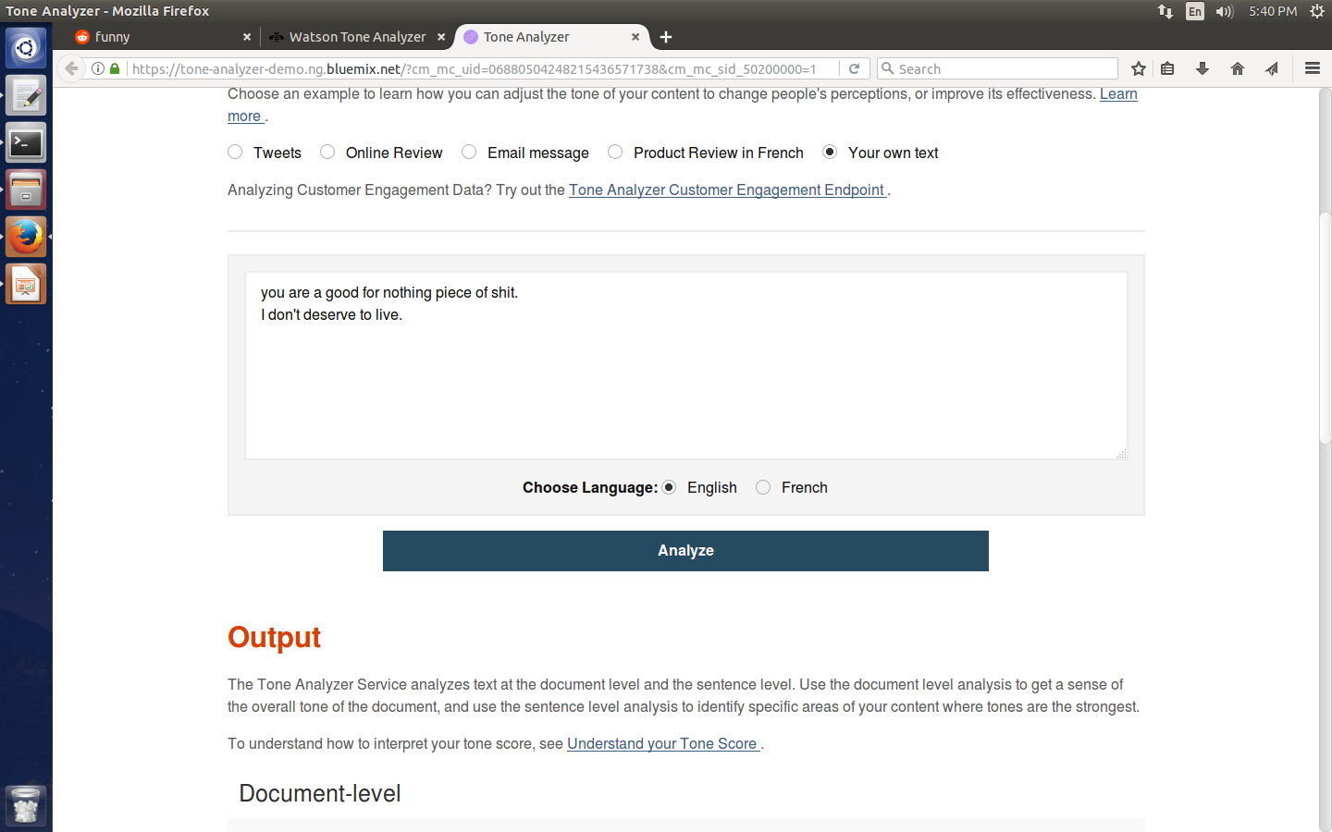
How do we get our data ?
Data scrapping
We scrape data in real time from Twitter,
Android Apps and even web pages
Timeline/social platforms
Voice
OR
Chats
3

Slide 4

Why ML and data analysis ?
Watson API
Content
PROTECTION FROM CYBERBULLYING
4

Slide 5
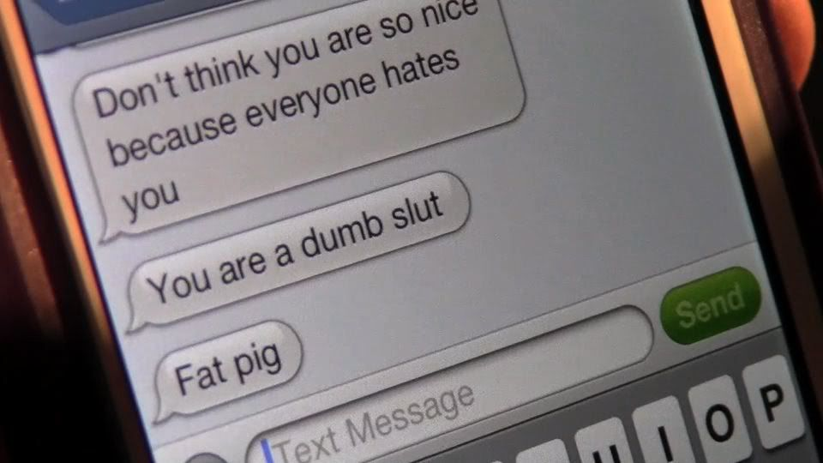
How do we do it ?
Recurring one sided messages
Anger messages/ taunting messages
5

Slide 6
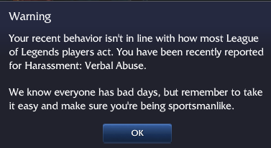
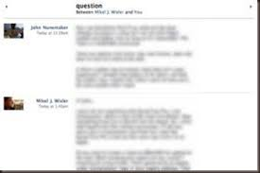
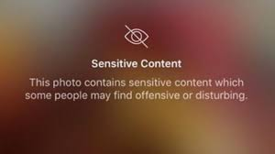
RESPONSE IN FUTURE
1
Blurring The bullying tweets
Android Giving a Warning message
6

Slide 7
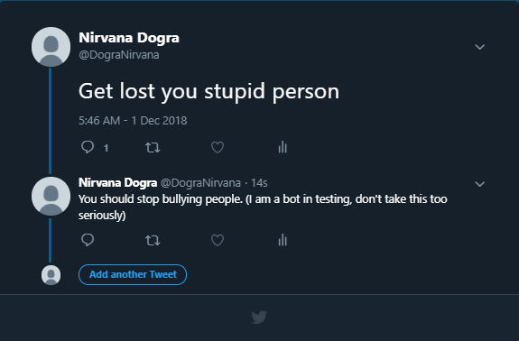
Prevention is better than cure
To stop you from spreading hate on twitter

